Slide 1

POSITIVENTURES
empowering positive change

Slide 2

POSITIVENTURES
startup consulting redefined
ecosystems for digital businesses
We are a unique strategic consultancy, specialising in business development and public relations for startups. Our services include:
Networking
Fundraising
Market research
Public relations
Lead generation
Startup Acceleration
Strategic consulting
Business development
We provide custom-tailored solutions designed with deep understaning of fintech, martech, consumertech and professional services sectors in the specific
conditions of the Polish market.
“We believe in added value and disruptive business models re-shaping the world”

Slide 3
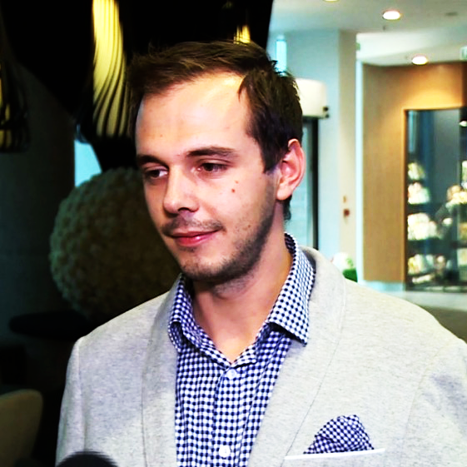

POSITIVENTURES
Kuba Jugo
strategic consulting and communications
Marketing and public relations consultant with over 10 years of experience, specialising in strategic advisory to B2B digital businesses, startups and scale-ups. Has worked with dozens of brands, helping them succeed in building visibility in Poland and the UK.
Kasia Maryanska
startup ecosystems and business development
Experienced project manager specialising in business development, with a vast network of connections in polish startup scene. Kasia helps B2B and B2C startups to build meaningful relationships with investors, public sector and business ecosystems in Poland, or reach a higher level of development through accelerations programs.
“Some inspirational quote something goes here"

Slide 4
















POSITIVENTURES
Experience
we work across diverse array of sectors
“Some inspirational quote something goes here"

Slide 5

POSITIVENTURES
How do we work
We can help you in multiple ways
We prepare market reports and sector analysis
We design and execute holistic marketing strategies and campaigns
We can build your visibility in top polish business media
We source leads and organize successful networking events and 1:1 meetings
We create high quality, engaging content for B2B audiences
We facilitate cooperation with think-tanks, public institutions and academia
We support your fundraising processes
We can help you build your supply chain in Poland
We educate executives in the specifics of running their business in Poland
We can support the logistics of setting up your office in Poland

Slide 6
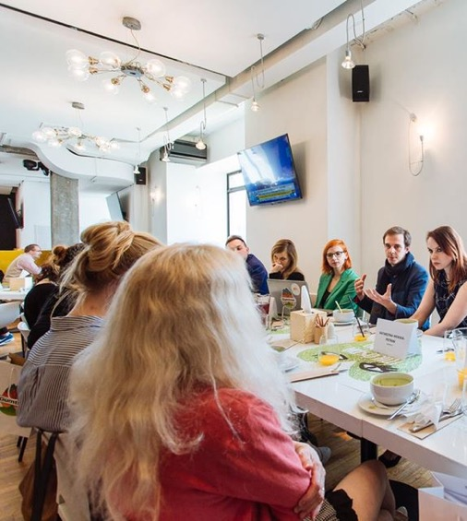
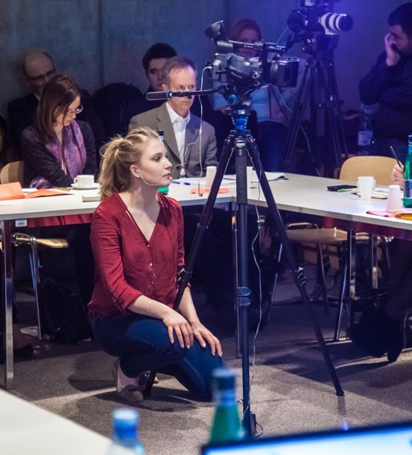
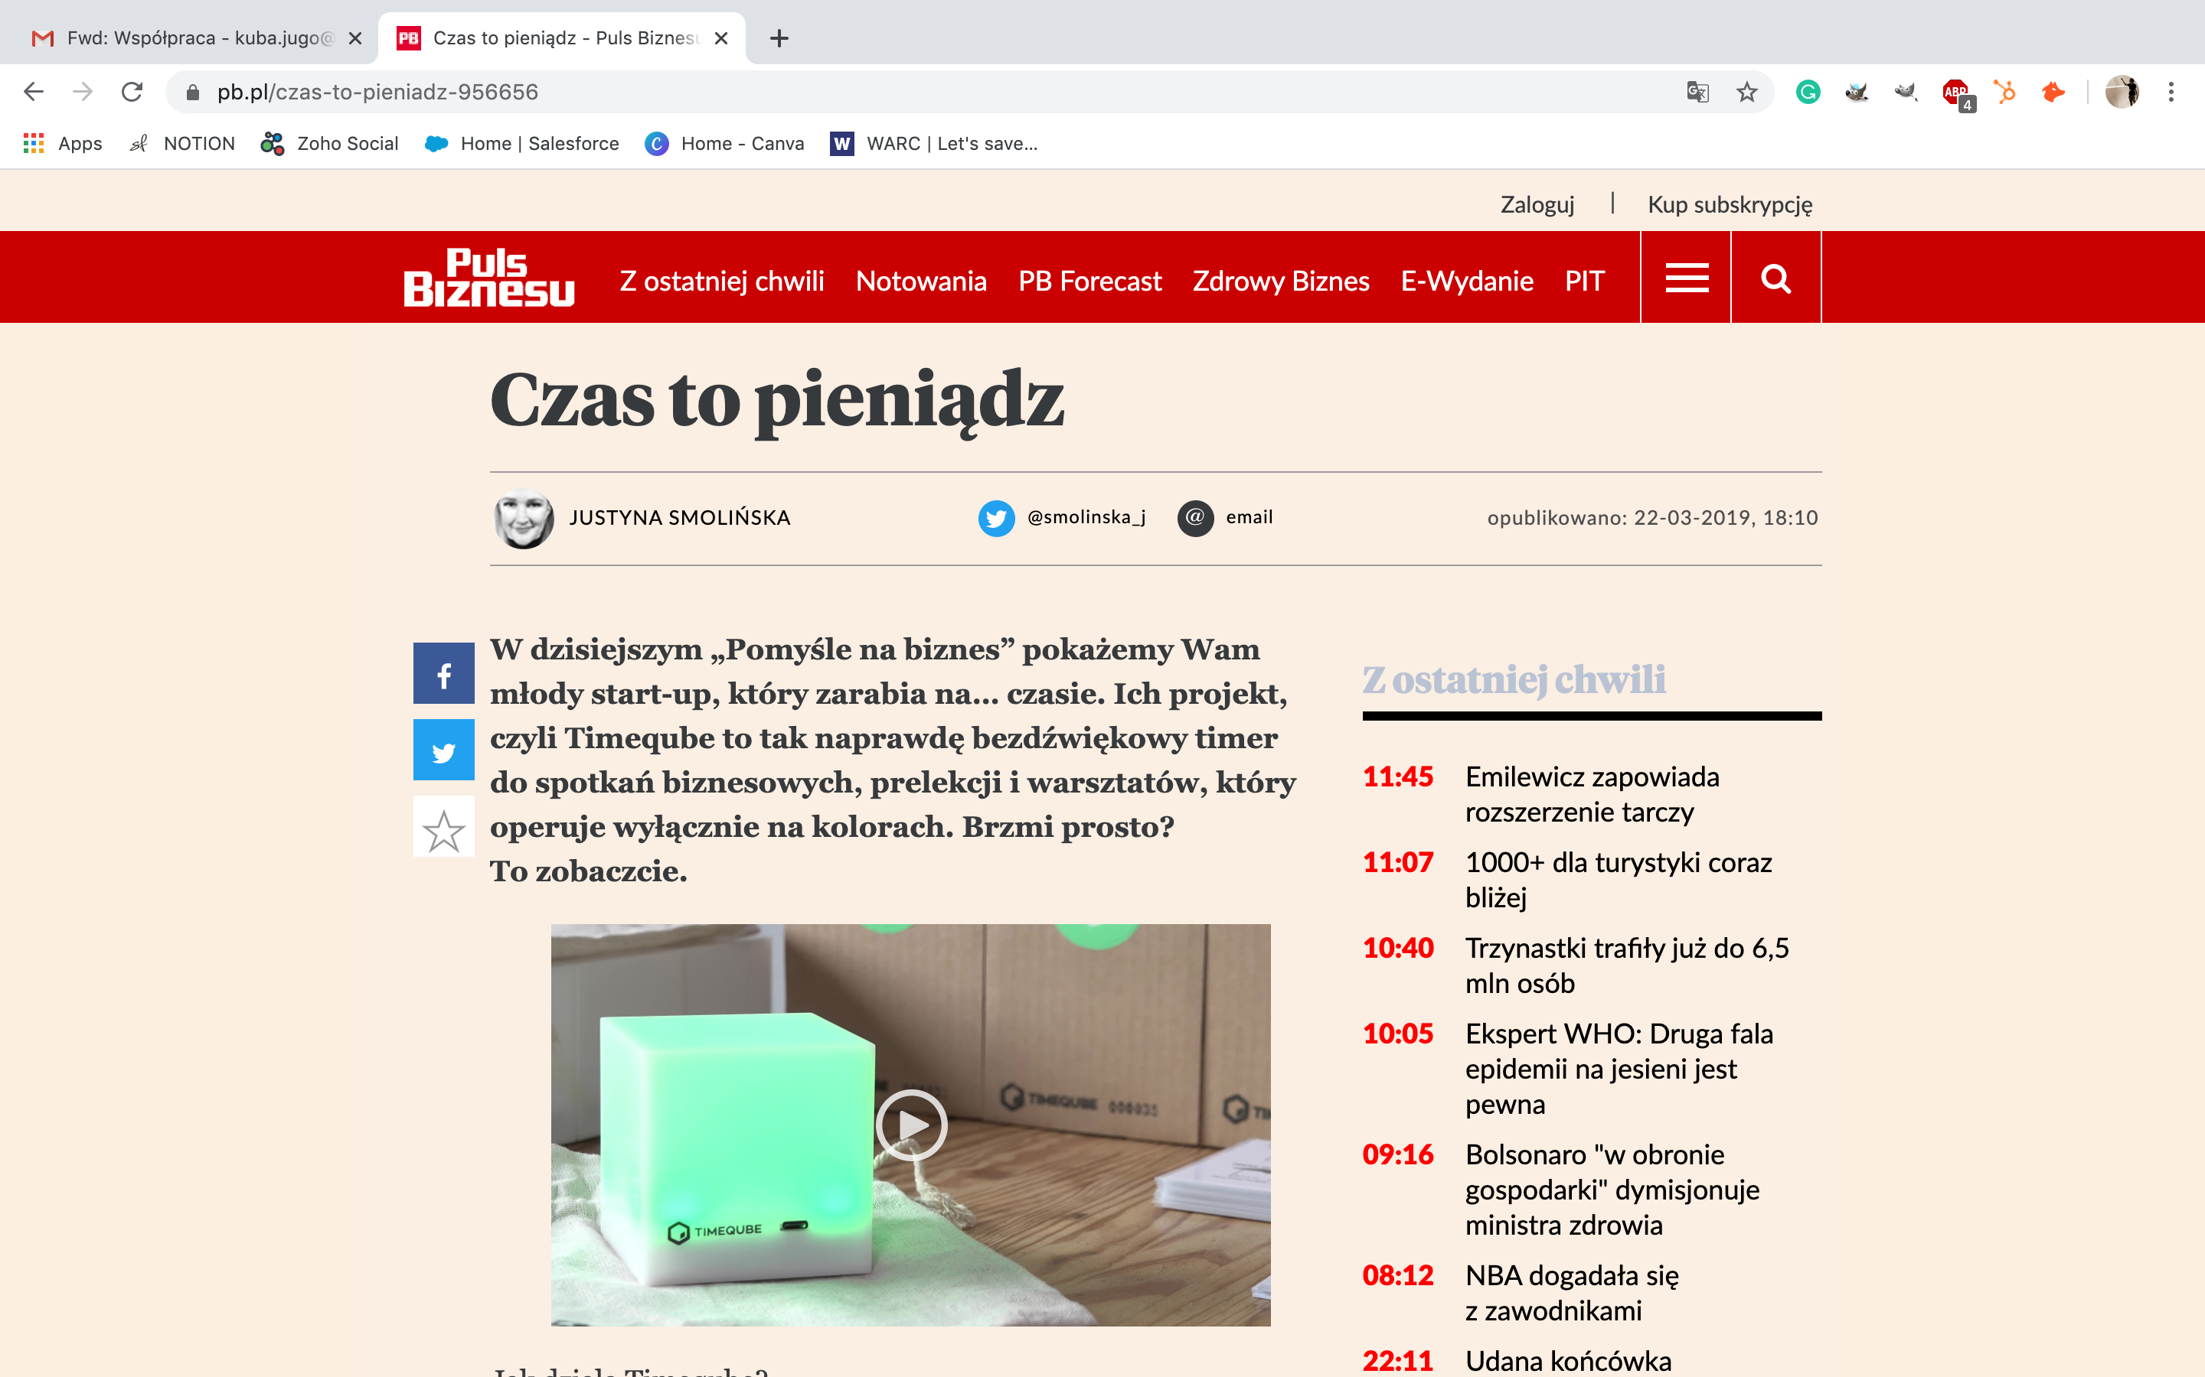
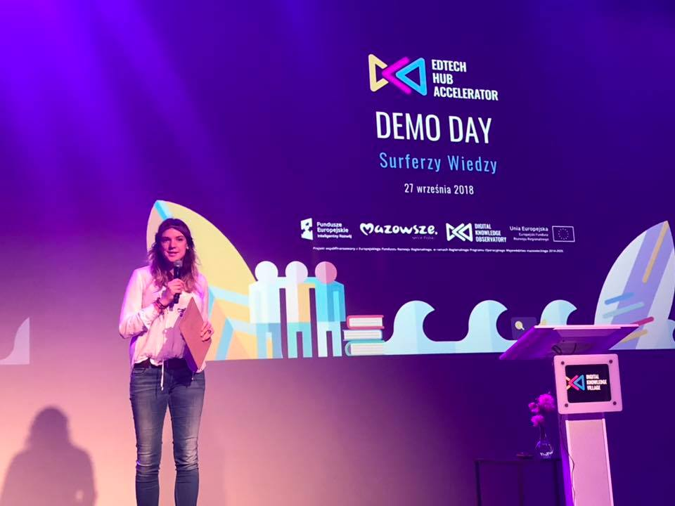
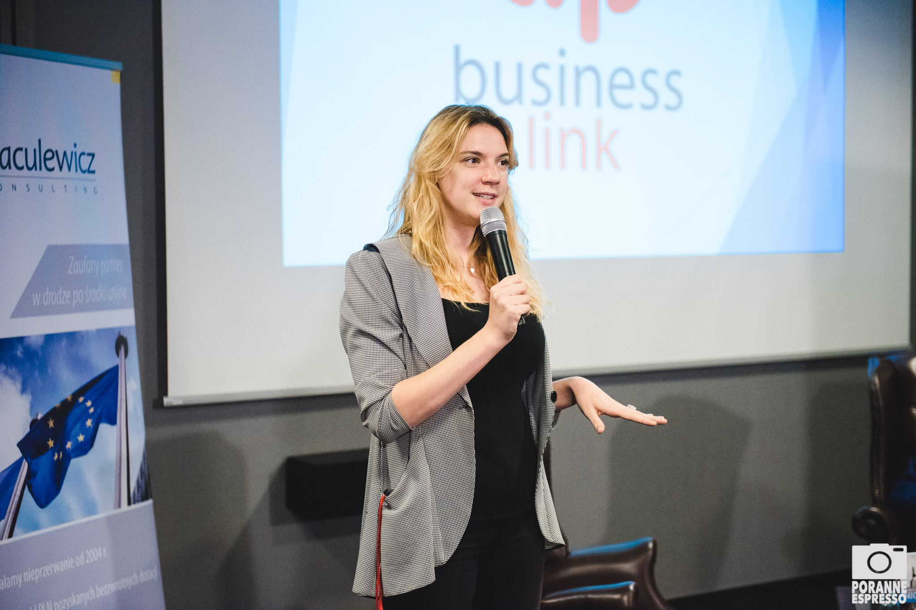
POSITIVENTURES
Examples of our work
Business development and networking events
(WorkService, 2019)
Market research and content develoipment
(Gumtree, 2018)
Media relations
(Gemius, 2017)
Cooperation with public sector
(DELab UW and Ministry of Foreign Affairs, 2016)
Media relations
(Timeqube, 2019)
Training courses
(Marketing w praktyce, 2019)
Startup events
(Digital Knowledge, 2018)
Networking projects
(Business Link, 2017)

Slide 7
POSITIVENTURES
Pricing
Simple and clear
After years of experience in freelance consulting we’ve decided to simplify the pricing of our services to a minimum.
We work on retainer, with a daily rate of
1000 PLN NET.
As simple as that. But 100% worth it!
Send us your brief and have let’s have a chat!
Ideation session and estimations are free of charge!
kuba.jugo@gmail.com
+44 7552 310 385
katarzyna.maryanska@gmail.com
+48 509 608 389

Slide 8
SEE YOU SOON!
POSITIVENTURES
empowering positive change

